Slide 1
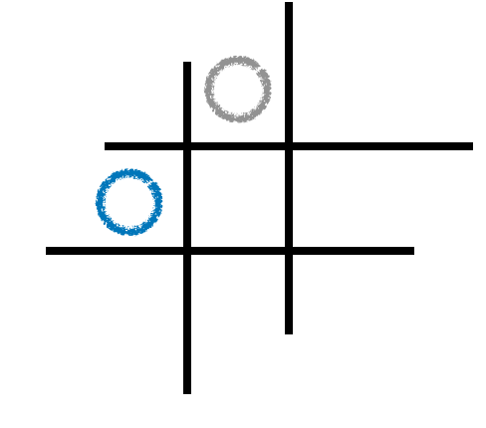
14282 – After the Gomoku Battle
I2P(II) / Mid2 Practice

Slide 2
Introduction
Design a program that analyzes the game records of two players in Tic-tac-toe and Connect4 and determines the winner of each game.
Tic-tac-toe
Connect4
3 in a row
4 in a row
Cited from https://commons.wikimedia.org/wiki/File:TicTacToe-152374698XOp.gif and https://mathworld.wolfram.com/Connect-Four.html

Slide 3
Introduction
Inheritance and polymorphism in C++ promote code reuse and flexibility, enhancing maintainability and scalability. In this task,
the structure of TicTacToeBoard and ConnectFourBoard classes might be similar.
Define the Board class to encapsulate the common elements,
and then inherit from it to specify details tailored to each game.

Slide 4
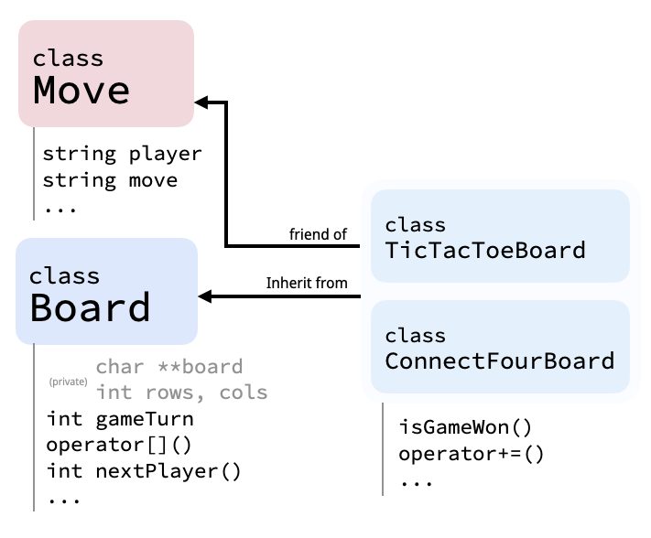
Introduction

Slide 5
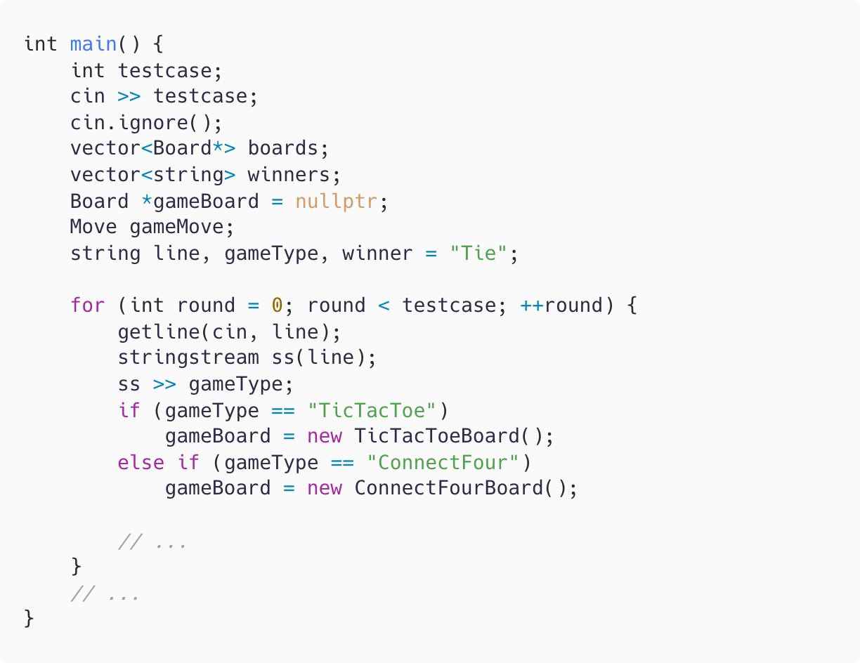
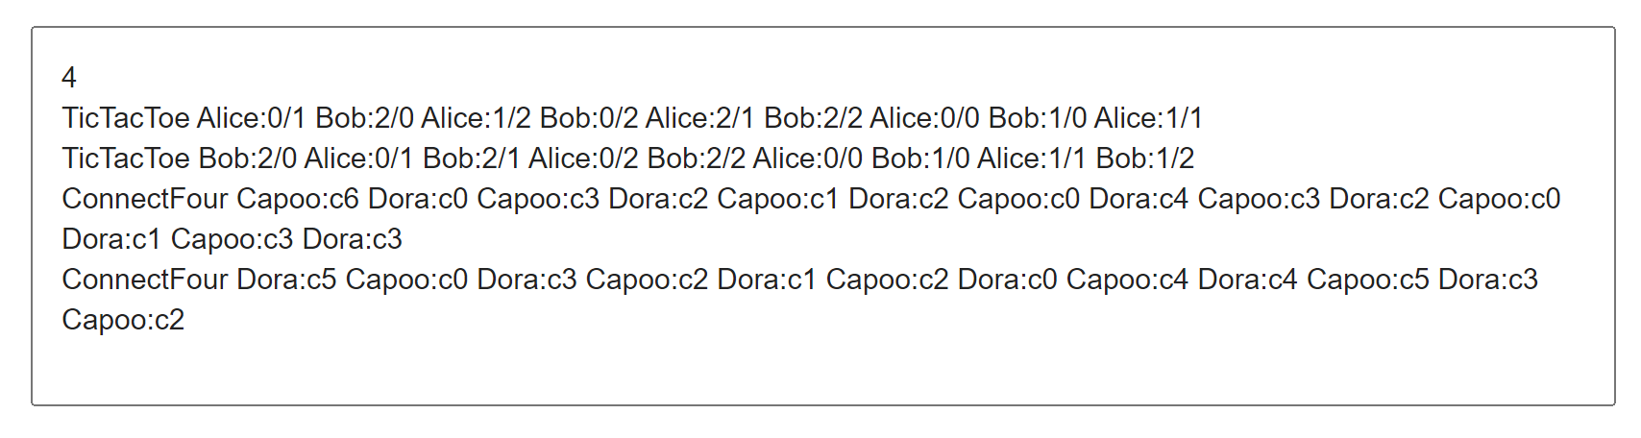
Introduction
main.cpp
main()
Use vector boards and winners
to store the statuses of the boards of ended
games and the corresponding winners.
For each round, use getline() and
stringstream to read the record,
extracting each string one by one.

Slide 6
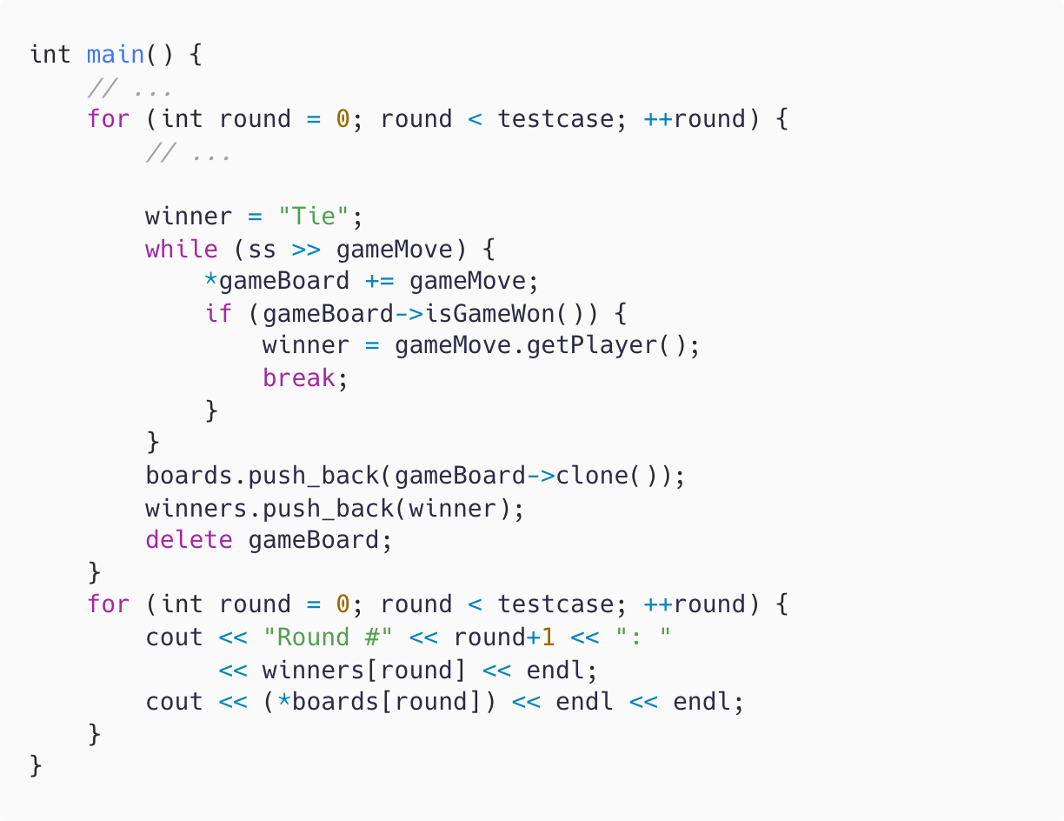
Introduction
main()
For each round:
Use += to perform a move on the board.
Invoke isGameWon() to check whether the game has ended.
Record the copied gameboard and the name of the winner.
After all rounds, output the boards of the ended games and their corresponding winners.
main.cpp

Slide 7
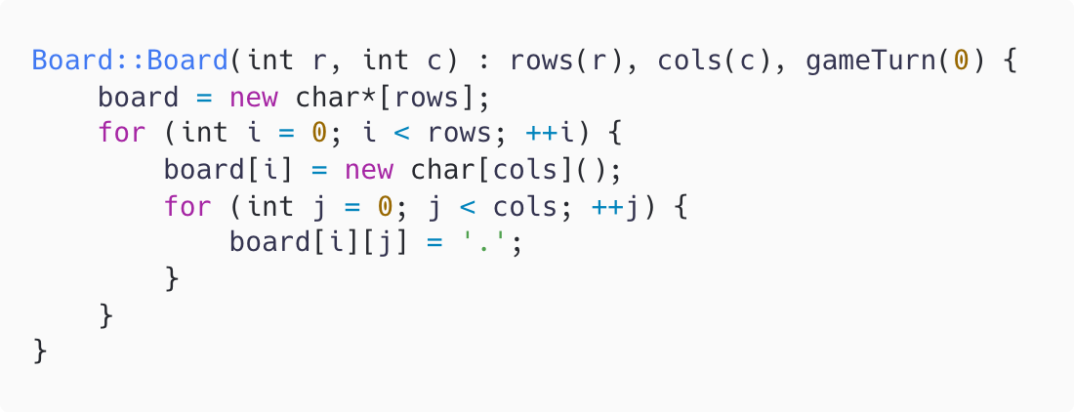
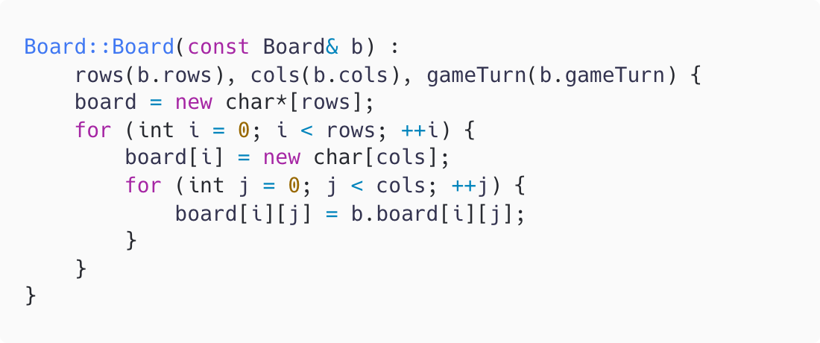
Implementation
Board::Board(int r, int c)
Constructor:
Instantiate the Board class and
initialize each element in the board array.
Board::Board(const Board& b)
Copy constructor:
Instantiate the Board class and
copy the values from another instance.

Slide 8
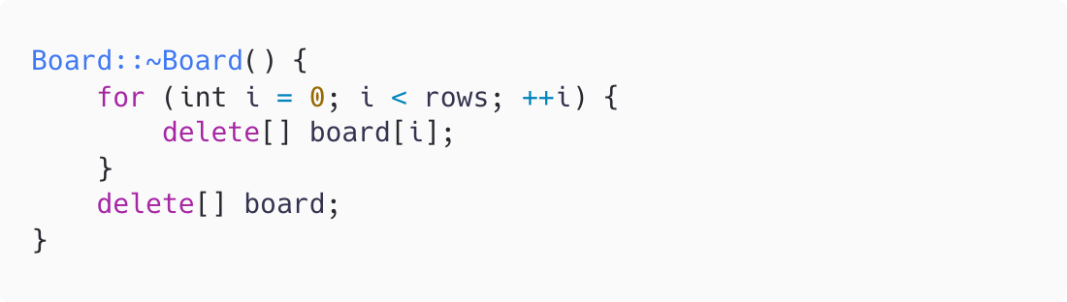
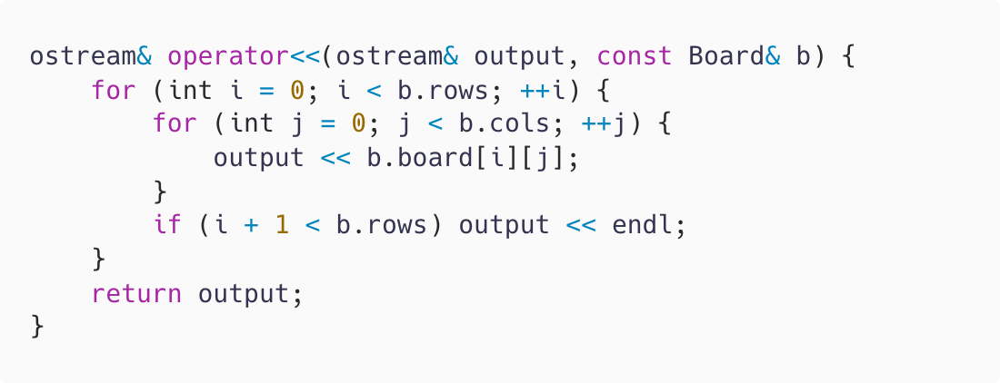
Implementation
Board::~Board(int r, int c)
Destructor:
Release the allocated memory.
ostream& operator<<(ostream& output, const Board& b)
Overload the << operator to
output the status of the board.

Slide 9
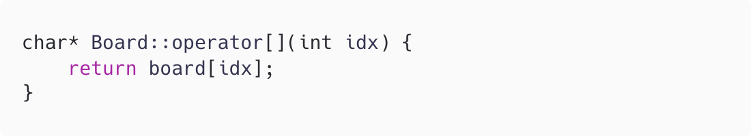
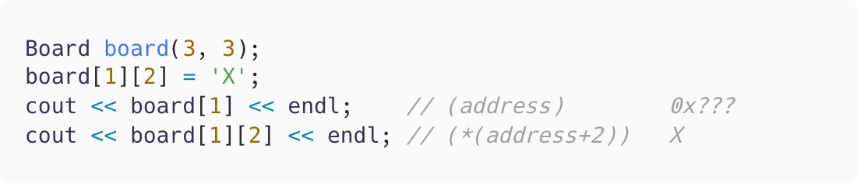
Implementation
char* Board::operator[](int idx)
Overload the [] operator to allow access
to values at specific locations.
Return a pointer pointing to the
first element of the idx^{th} row.
Example

Slide 10
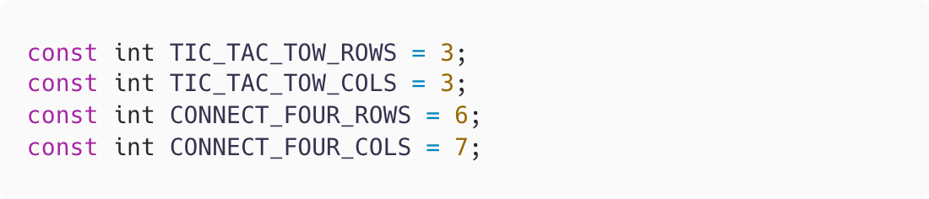


Implementation
TicTacToeBoard()
ConnectFourBoard()
Use the constructor of the Board class
to instantiate the derived classes:
TicTacToeBoard and ConnectFourBoard
with the desired size.

Slide 11
Implementation
TicTacToeBoard& operator+=(const Move& m)
ConnectFour& operator+=(const Move& m)
Overload the += operator to perform a move on the board.

Slide 12
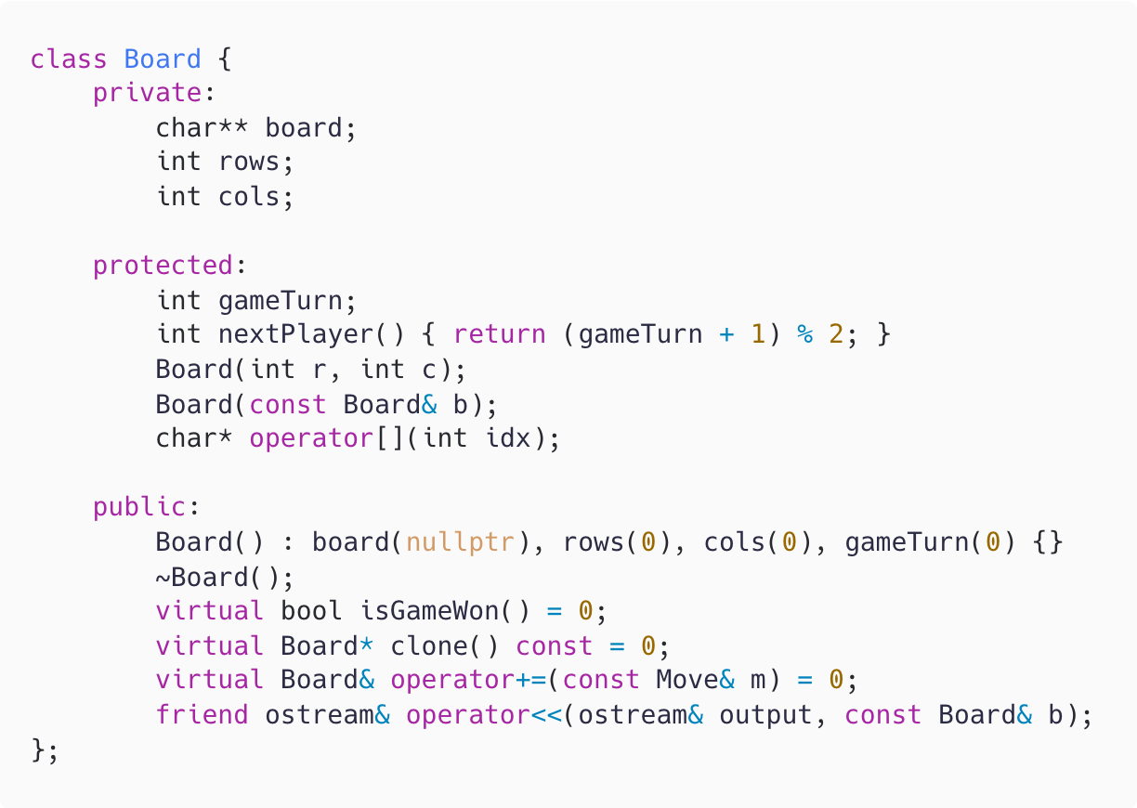
Implementation
TicTacToeBoard& operator+=(const Move& m)
ConnectFour& operator+=(const Move& m)
Notice. Accessing Board::board
The board array is private within the Board class, so the derived class cannot directly access this variable.
However, the overloaded [] operator is protected within the Board class,
allowing the derived class to access the board array using it.
function.h

Slide 13
Implementation
TicTacToeBoard& operator+=(const Move& m)
ConnectFour& operator+=(const Move& m)
Notice. Accessing Board::board
The board array is private within the Board class, so the derived classes cannot directly access this variable.
However, the overloaded [] operator is protected within the Board class,
allowing the derived classes to access the board array using it.
function.h

Slide 14
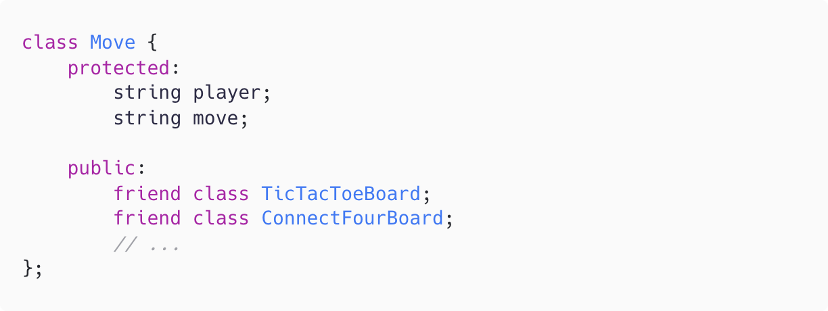
Implementation
TicTacToeBoard& operator+=(const Move& m)
ConnectFour& operator+=(const Move& m)
Notice. Accessing Move::move
Since TicTacToeBoard / ConnectFourBoard are declared as friend classes of Move, these two classes can access the members of Move directly.
function.h

Slide 15

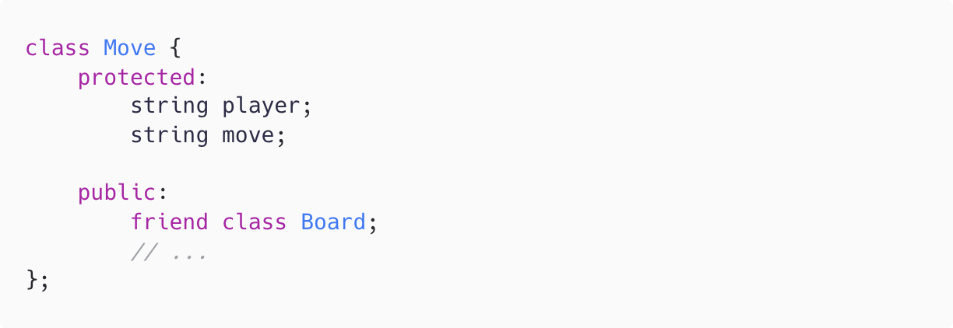
Implementation
TicTacToeBoard& operator+=(const Move& m)
ConnectFour& operator+=(const Move& m)
Notice. Accessing Move::move
If the code is slightly modified to define the Board class as a friend of the Move class, then the derived classes of Board cannot access Move’s protected members.
function.h

Slide 16
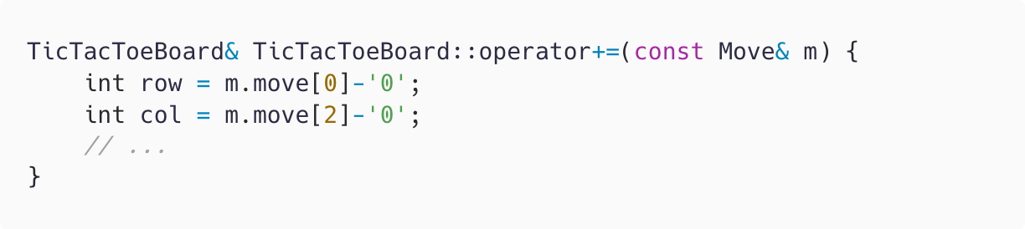
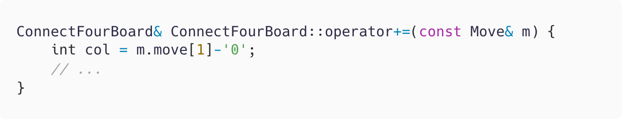
Implementation
TicTacToeBoard& operator+=(const Move& m)
ConnectFour& operator+=(const Move& m)
Step 1: Parse the move.
The string indicating the
move performed is formatted as follows:
Tic-tac-toe <row>/<column> Connect4 c<column>

Slide 17
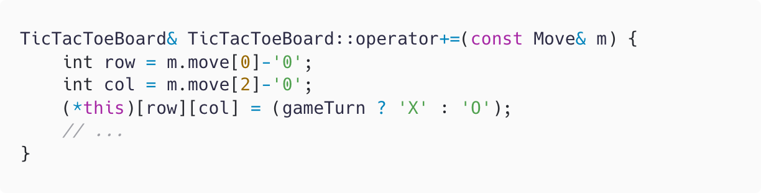
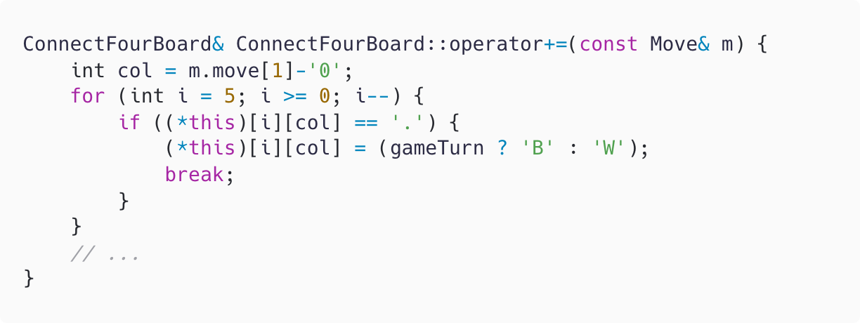
Implementation
TicTacToeBoard& operator+=(const Move& m)
ConnectFour& operator+=(const Move& m)
Step 2: Perform the move.
(*this) refers to the instance of TicTacToeBoard / ConnectFourBoard,
both inheriting from the Board class.
Use the [] operator to access the board array, which is declared as private in the Board class.

Slide 18
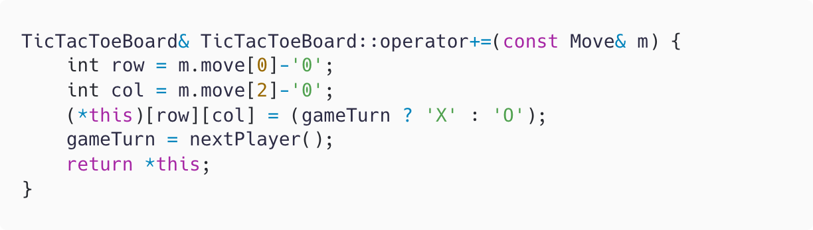
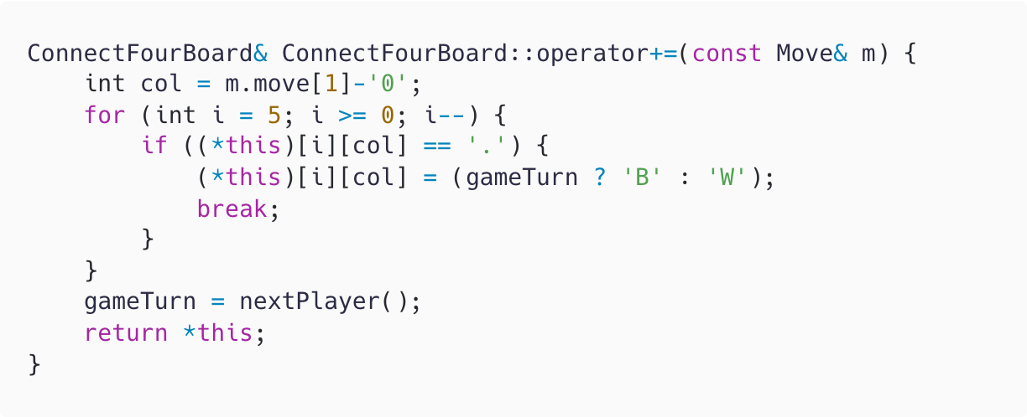
Implementation
TicTacToeBoard& operator+=(const Move& m)
ConnectFour& operator+=(const Move& m)
Step 3: Alternate the player and return
After performing the move,
call nextPlayer() to change the player value defined in the Board class.

Slide 19
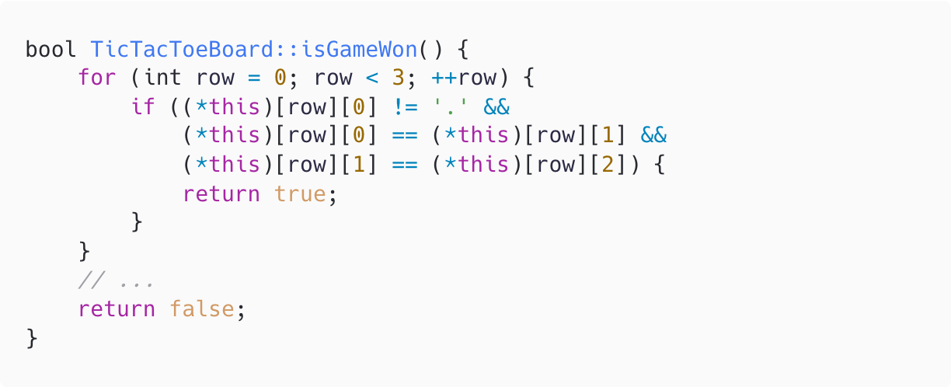
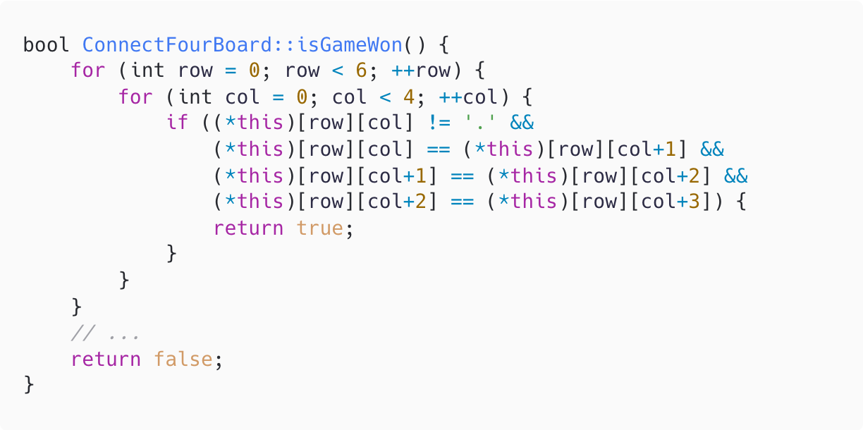
Implementation
bool TicTacToeBoard::isGameWon()
bool ConnectFourBoard::isGameWon()
Use the [] operator to access the board,
like the approach used in the += operator, and check if someone is winning the game.

